Slide 1
Applied Statistical Analysis
EDUC 6050
Week 10
Finding clarity using data

Slide 2
Today
REGRESSION!

Slide 3
Comparing Means
Assessing Relationships
Is there a relationship between the two variables?
Correlation
Regression
Is one group different than the other(s)?
Z-tests
T-tests
ANOVA
We look at how much the variables “move together”
We compare the means and use the variability to decide if the difference is significant

Slide 4
Comparing Means
Assessing Relationships
Is there a relationship between the two variables?
Correlation
Regression
Is one group different than the other(s)?
Z-tests
T-tests
ANOVA
Regression does both (can be at the same time)
We look at how much the variables “move together”
We compare the means and use the variability to decide if the difference is significant

Slide 5
Intro to Regression
The foundation of almost everything we do in statistics
Comparing group means
Assess relationships
Compare means AND assess relationships at the same time
Can handle many types of outcome and predictor data types
Results are interpretable

Slide 6
Logic of Regression
We are trying to find the best fitting line
Y
X

Slide 7
Logic of Regression
We are trying to find the best fitting line
We do this by minimizing the difference between the points and the line (called the residuals)
Y
X

Slide 8
Logic of Regression
Average of X
Line always goes through the averages of X and Y
Y
Average of Y
X

Slide 9
Two Main Types of Regression
Simple
Multiple
Only one predictor in the model
When variables are standardized, gives same results as correlation
When using a grouping variable, same results as t-test or ANOVA
More than one variable in the model
When variables are standardized, gives “partial” correlation
Predictors can be any combination of categorical and continuous

Slide 10
Two Main Types of Regression
Simple
Multiple
Only one predictor in the model
When variables are standardized, gives same results as correlation
When using a grouping variable, same results as t-test or ANOVA
More than one variable in the model
When variables are standardized, gives “partial” correlation
Predictors can be any combination of categorical and continuous

Slide 11
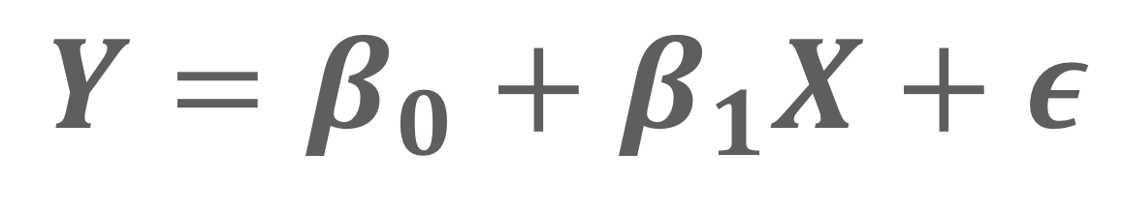
Simple Linear Regression
Only one predictor in the model
When variables are standardized, gives same results as correlation
When using a grouping variable, same results as t-test or ANOVA
$$Y=β_{0}+β_{1}X+ε$$

Slide 12
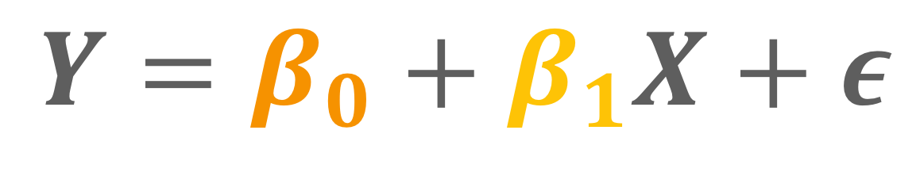
Simple Linear Regression
Only one predictor in the model
When variables are standardized, gives same results as correlation
When using a grouping variable, same results as t-test or ANOVA
slope
$$Y=β_{0}+β_{1}X+ε$$
intercept

Slide 13
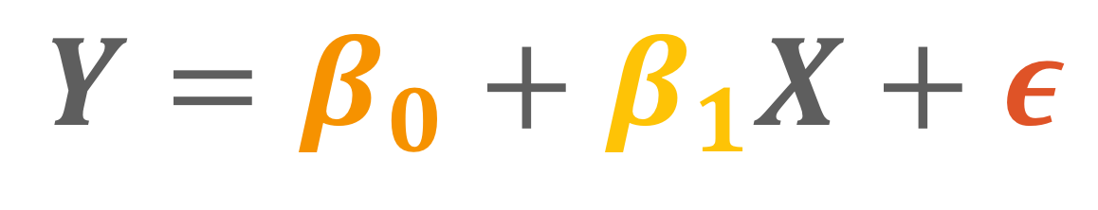
Simple Linear Regression
Only one predictor in the model
When variables are standardized, gives same results as correlation
When using a grouping variable, same results as t-test or ANOVA
slope
$$Y=β_{0}+β_{1}X+ε$$
unexplained stuff in Y
intercept

Slide 14
Simple Linear Regression
Only one predictor in the model
When variables are standardized, gives same results as correlation
When using a grouping variable, same results as t-test or ANOVA
We have two variables, X and Y, the predictor and outcome. We want to know if increases/decreases in X are associated (or predict) changes in Y.
Example

Slide 15
Simple Linear Regression
Only one predictor in the model
When variables are standardized, gives same results as correlation
When using a grouping variable, same results as t-test or ANOVA
X | Y
3 | 9
2 | 7
4 | 8
4 | 6
5 | 9
Example

Slide 16
Regression vs. Correlation
Very related
In simple regression, when variables are standardized, they are the same thing
(just with directionality in regression)
Jamovi provides both standardized and non-standardized results

Slide 17
Quick Note: Models
Models are just simplifications of the world that help us describe it
“All models are wrong, but some models are useful.” - George E.P. Box (1979)
A model is useful when it represents reality and is concise enough to understand and act on it

Slide 18
General
Requirements
ID | X | Y
1 | 8 | 7
2 | 6 | 2
3 | 9 | 6
4 | 7 | 6
5 | 7 | 8
6 | 8 | 5
7 | 5 | 3
8 | 5 | 5
Two or more variables,
Outcome needs to be continuous
Others can be continuous or categorical

Slide 19
Hypothesis Testing with Simple Regression
The same 6 step approach!
Examine Variables to Assess Statistical Assumptions
State the Null and Research Hypotheses (symbolically and verbally)
Define Critical Regions
Compute the Test Statistic
Compute an Effect Size and Describe it
Interpreting the results

Slide 20
Examine Variables to Assess Statistical Assumptions
1
Basic Assumptions
Independence of data
Appropriate measurement of variables for the analysis
Normality of distributions
Homoscedastic

Slide 21
Examine Variables to Assess Statistical Assumptions
1
Basic Assumptions
Independence of data
Appropriate measurement of variables for the analysis
Normality of distributions
Homoscedastic
Individuals are independent of each other (one person’s scores does not affect another’s)

Slide 22
Examine Variables to Assess Statistical Assumptions
1
Basic Assumptions
Independence of data
Appropriate measurement of variables for the analysis
Normality of distributions
Homoscedastic
Here we need interval/ratio outcome
Notes:
For F-test, DV needs to be interval/ratio

Slide 23
Examine Variables to Assess Statistical Assumptions
1
Basic Assumptions
Residuals should be normally distributed
Independence of data
Appropriate measurement of variables for the analysis
Normality of distributions
Homoscedastic

Slide 24
Examine Variables to Assess Statistical Assumptions
1
Basic Assumptions
Independence of data
Appropriate measurement of variables for the analysis
Normality of distributions
Homoscedastic
Variance around the line should be roughly equal across the whole line
Notes:
Example on board

Slide 25
Examine Variables to Assess Statistical Assumptions
1
Basic Assumptions
Independence of data
Appropriate measurement of variables for the analysis
Normality of distributions
Homoscedastic
Linear Relationships
No omitted variables
Notes:
Example on board

Slide 26
Examine Variables to Assess Statistical Assumptions
1
Basic Assumptions
Independence of data
Appropriate measurement of variables for the analysis
Normality of distributions
Homoscedastic
Linear Relationships
No omitted variables
Relationships between the outcome and the continuous predictors should be linear
Notes:
Example on board

Slide 27
Examine Variables to Assess Statistical Assumptions
1
Basic Assumptions
Independence of data
Appropriate measurement of variables for the analysis
Normality of distributions
Homoscedastic
Linear Relationships
No omitted variables
Any variable that is related to both the predictor and the outcome should be included in the regression model
Notes:
Example on board

Slide 28
Examine Variables to Assess Statistical Assumptions
1
Examining the Basic Assumptions
Independence: random sample
Appropriate measurement: know what your variables are
Normality: Histograms, Q-Q, skew and kurtosis
Homoscedastic: Scatterplots
Linear: Scatterplots
No Omitted: check correlations, know the theory

Slide 29
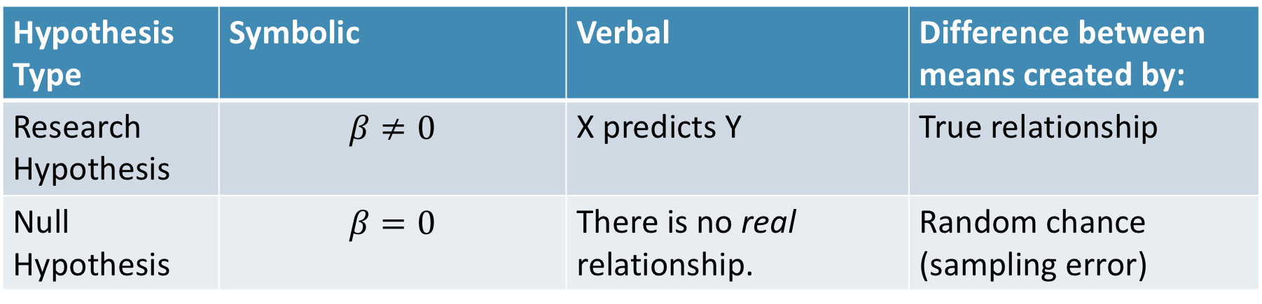
State the Null and Research Hypotheses (symbolically and verbally)
2
Hypothesis Type | Symbolic | Verbal | Difference between means created by:
Research Hypothesis | $$β≠0$$ | X predicts Y | True relationship
Null Hypothesis | $$β=0$$ | There is no real relationship. | Random chance (sampling error)
Notes:
Null and research hypotheses are mutually exclusive (they cover all possible outcomes)

Slide 30
Define Critical Regions
3
How much evidence is enough to believe the null is not true?
generally based on an alpha = .05
Use software’s p-value to judge if it is below .05

Slide 31
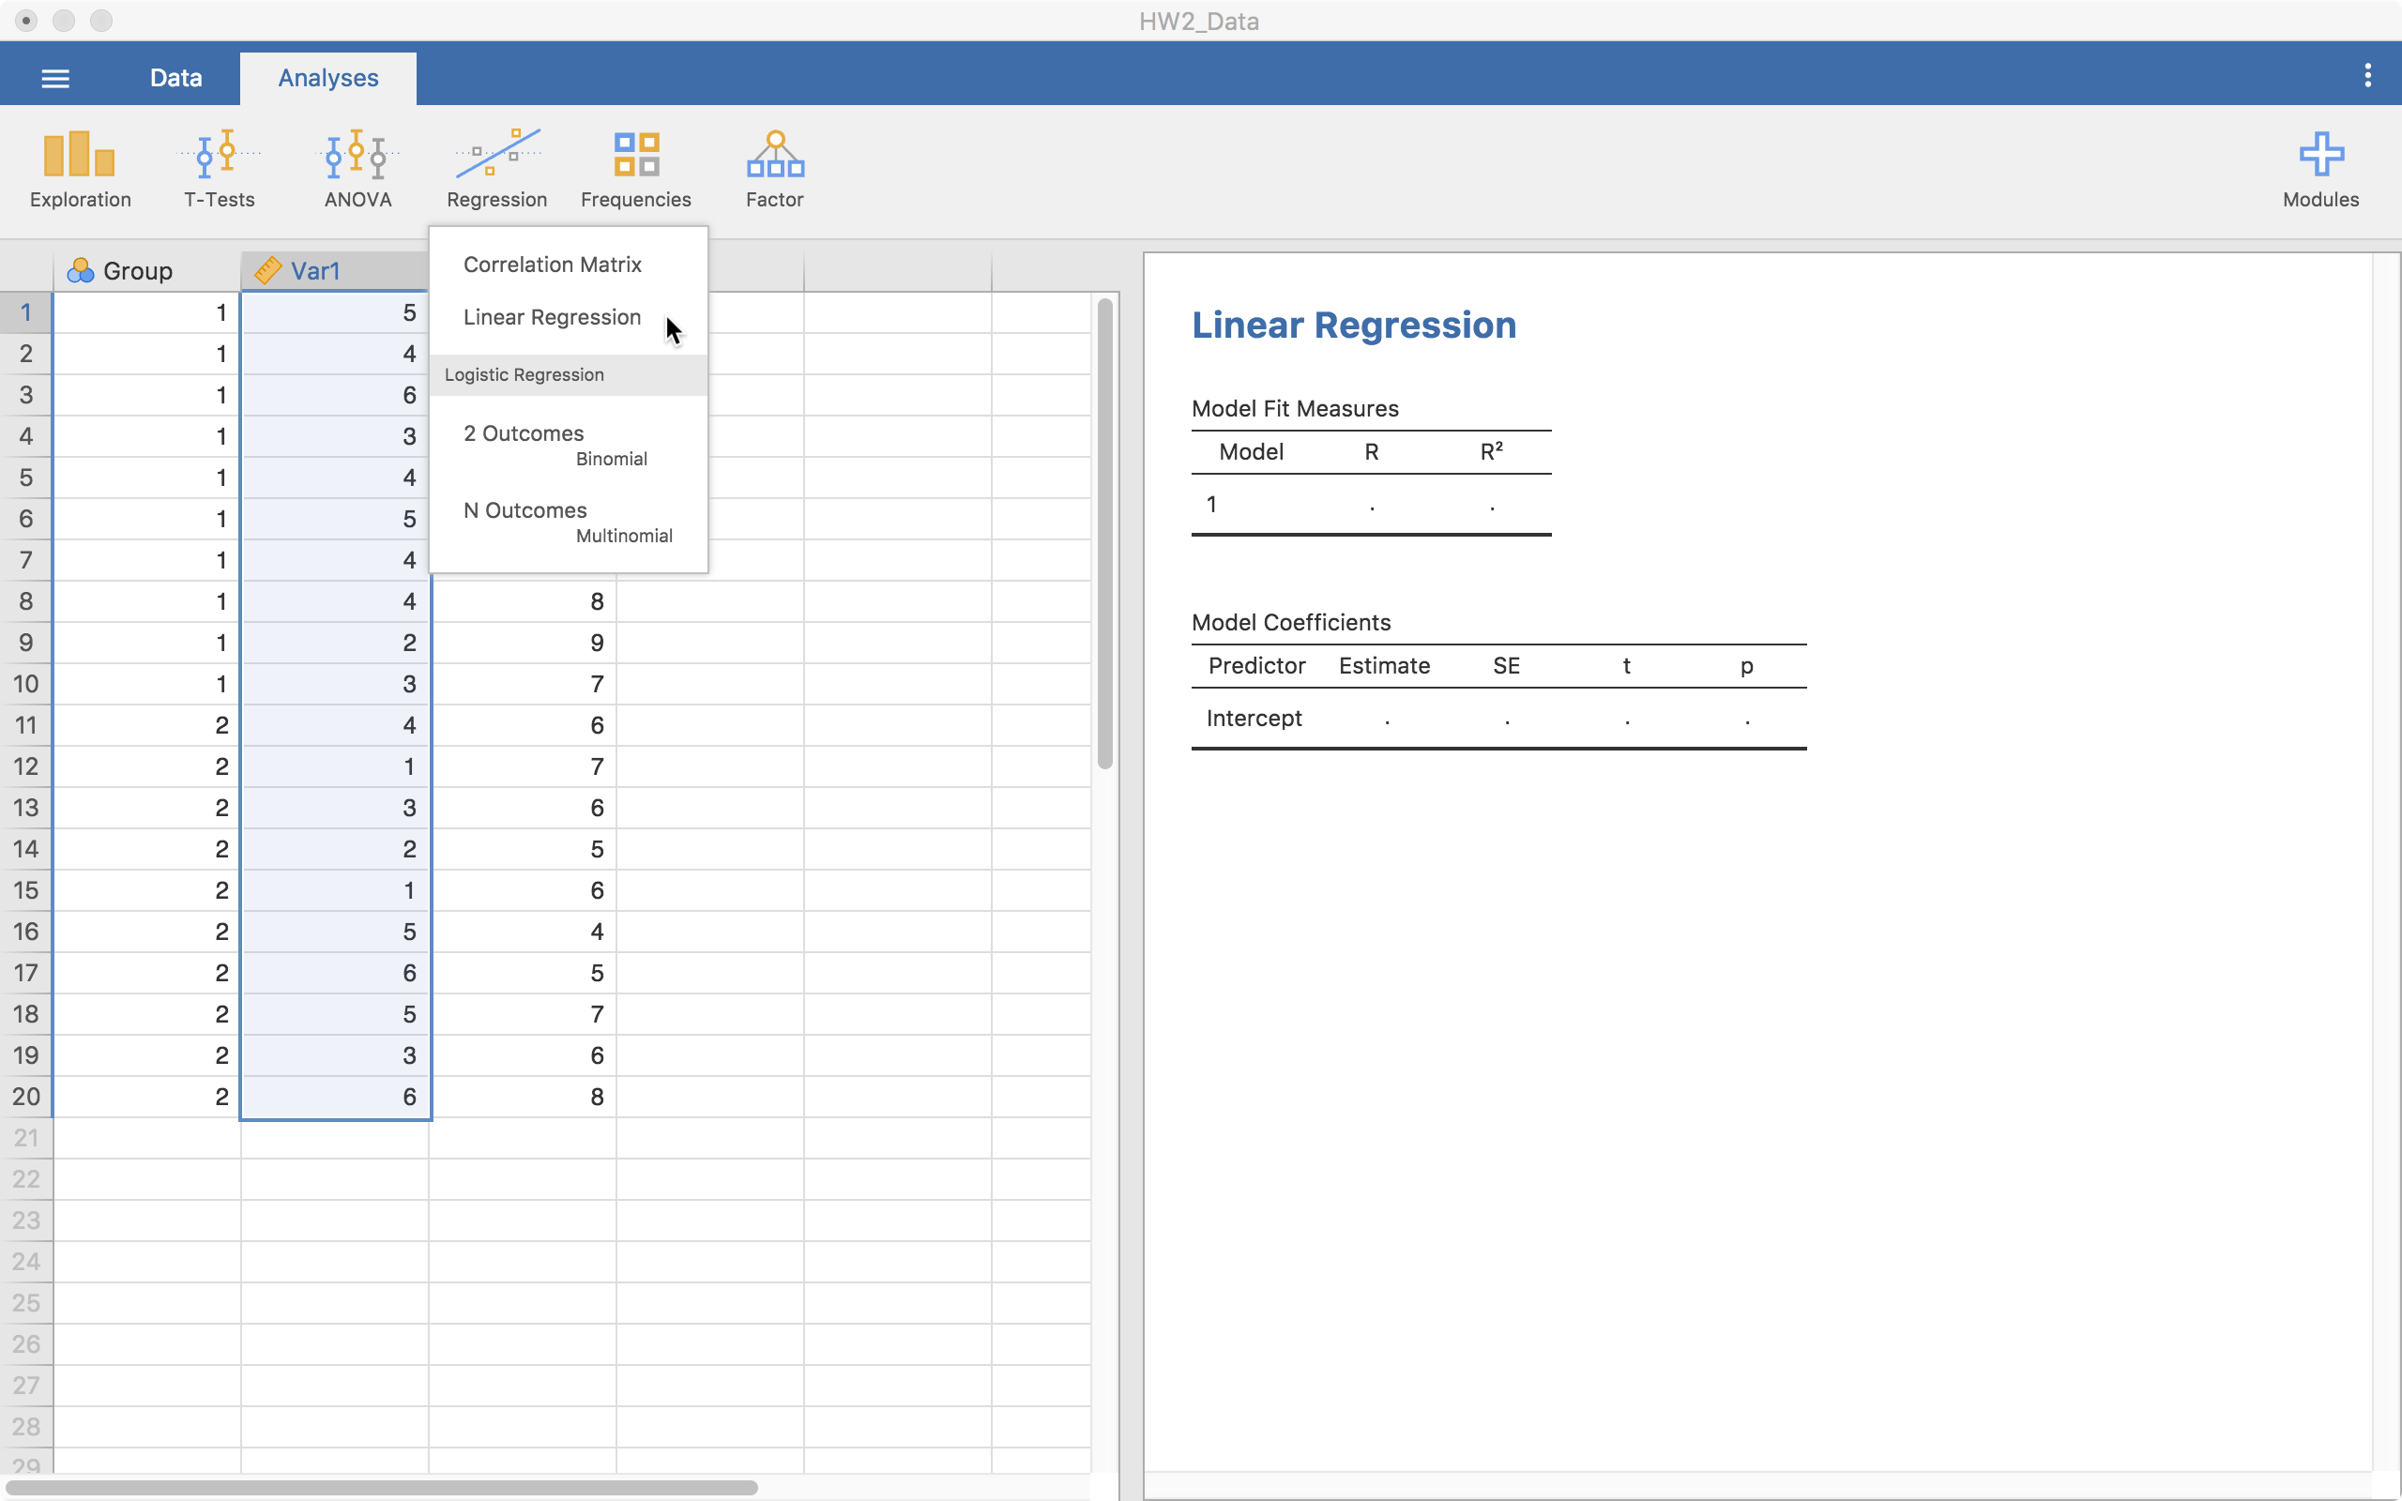
Compute the Test Statistic
4
Click on
“Linear Regression”

Slide 32
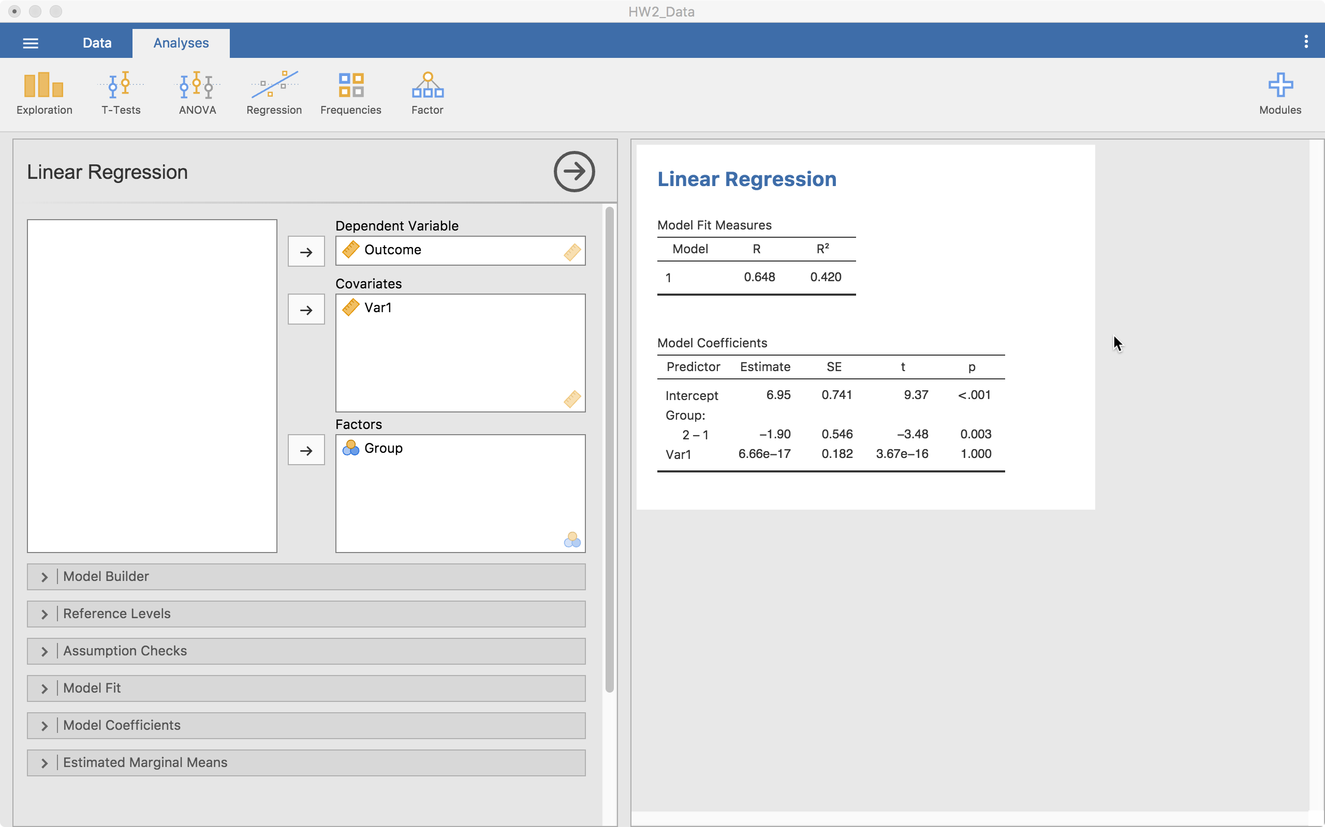
Compute the Test Statistic
4
Results
Outcome goes here
Continuous predictors go here
Other model options
Categorical predictors go here

Slide 33
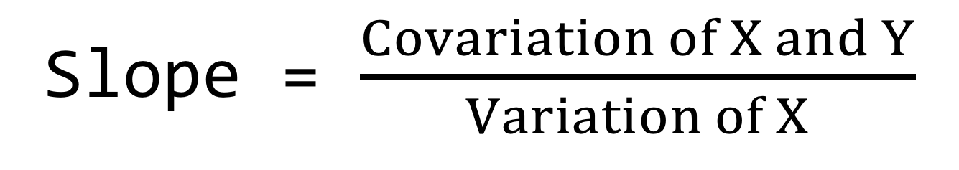
Compute the Test Statistic
4
Intercept = What Y is when
X is zero
Slope = $\frac{Covariation of X and Y}{Variation of X}$

Slide 34
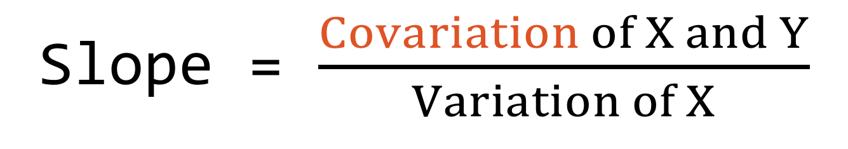
Compute the Test Statistic
4
Intercept = What Y is when
X is zero
Slope = $\frac{Covariation of X and Y}{Variation of X}$
The way the variables move together (just like in correlation)

Slide 35
Compute the Test Statistic
4
Intercept = What Y is when
X is zero
Slope = The change in Y for a one unit change in X, on average.

Slide 36
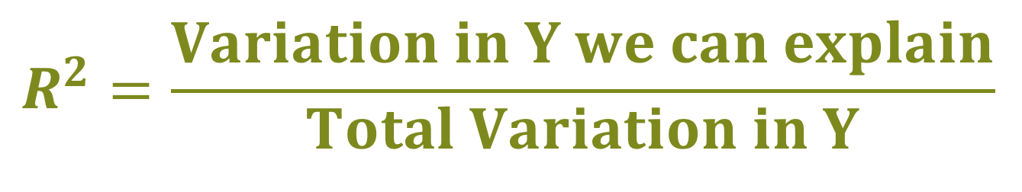
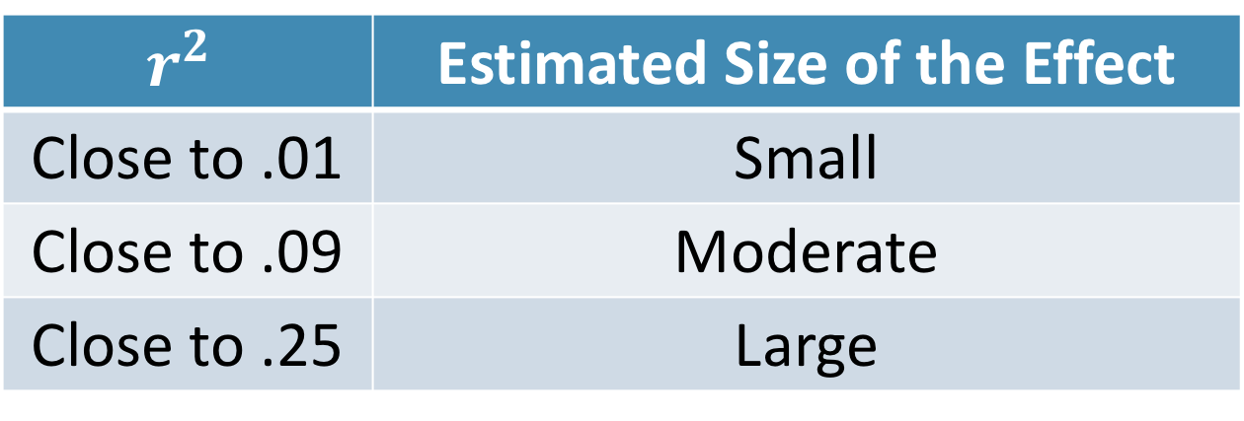
Compute an Effect Size and Describe it
5
One of the main effect sizes for regression is R²
$$R_{ }^{2}=\frac{Variation in Y we can explain}{Total Variation in Y}$$
$$r_{ }^{2}$$ | Estimated Size of the Effect
Close to .01 | Small
Close to .09 | Moderate
Close to .25 | Large
Notes:
Can also use Cohen’s d here as well for each mean difference

Slide 37
Interpreting the results
6
Put your results into words
The regression analysis showed that X significantly predicts Y (b = .5, p = .02). X accounted for 32% of the variation in Y.

Slide 38
Multiple Regression

Slide 39
Example of Simple Regression
Chocolate consumption looks like it might cause car accidents. Is this accurate? What else could explain it?
Car Accidents
Chocolate Consumption

Slide 40
What if we control for time of year?
There is no longer a relationship when we “take out” the part of the relationship that is related to time of the year
Car Accidents
Chocolate Consumption

Slide 41
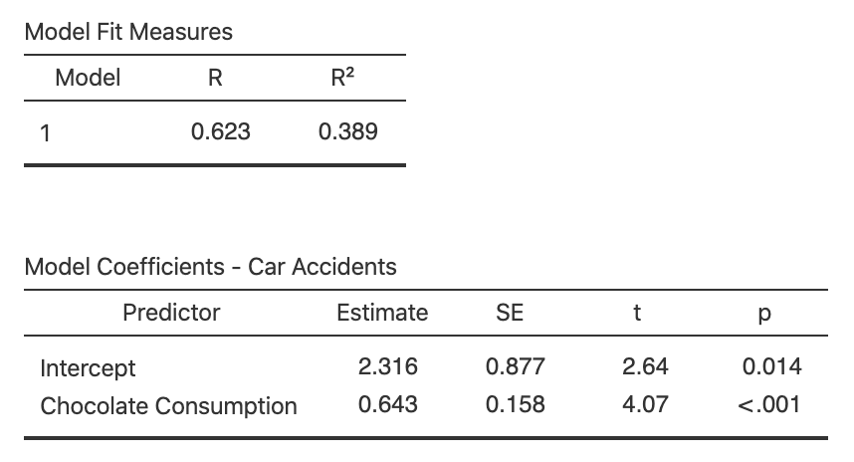
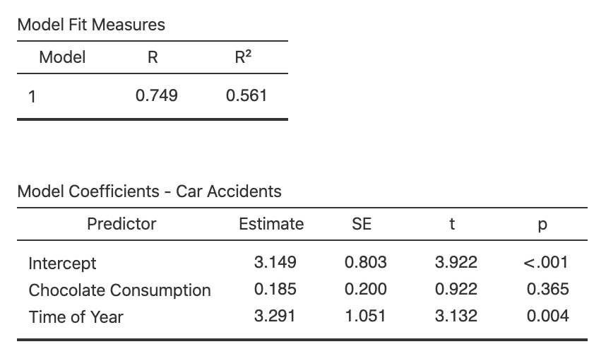
The two models
Simple Relationship
Relationship
Controlling for Time of Year

Slide 42
The two models
Simple Relationship
Relationship
Controlling for Time of Year

Slide 43
Two Main Types of Regression
Simple
Multiple
Only one predictor in the model
When variables are standardized, gives same results as correlation
When using a grouping variable, same results as t-test or ANOVA
More than one variable in the model
When variables are standardized, gives “partial” correlation
Predictors can be any combination of categorical and continuous

Slide 44
Multiple Regression
More than one predictor in the same model
This change the interpretation just a little:
Slope is now the change in Y for a one-unit change in X, while holding the other predictors constant.

Slide 45
Multiple Regression
More than one predictor in the same model
This change the interpretation just a little
Also changes what we
are estimating:

Slide 46
Multiple Regression
More than one predictor in the same model
This change the interpretation just a little
Also changes what we
are estimating:
A plane instead of a line

Slide 47
Multiple Regression
Provides us with a few more things to think about
1. Variable Selection
2. Assumption Checks
3. Multi-collinearity
4. Interactions

Slide 48
Variable Selection When Theory Is Unclear
Several Approaches
1. Forward
2. Backward
3. Lasso
4. Covariates then predictor of interest
I’d recommend these two
Notes:
Can report both the “adjusted” and “unadjusted” effects as well

Slide 49
Assumption Checks
Linearity and Homoskedasticity more difficult since it is now in 3+ dimensions
Jamovi makes these fairly straightforward

Slide 50
Multi-Collinearity
When two or more predictors are very related to each other or are linear combinations of each other
Check correlations
Dummy codes are correct (Jamovi does this automatically)

Slide 51
Interactions
When the effect of a predictor depends on another
Can have 2+ variables in the interaction

Slide 52
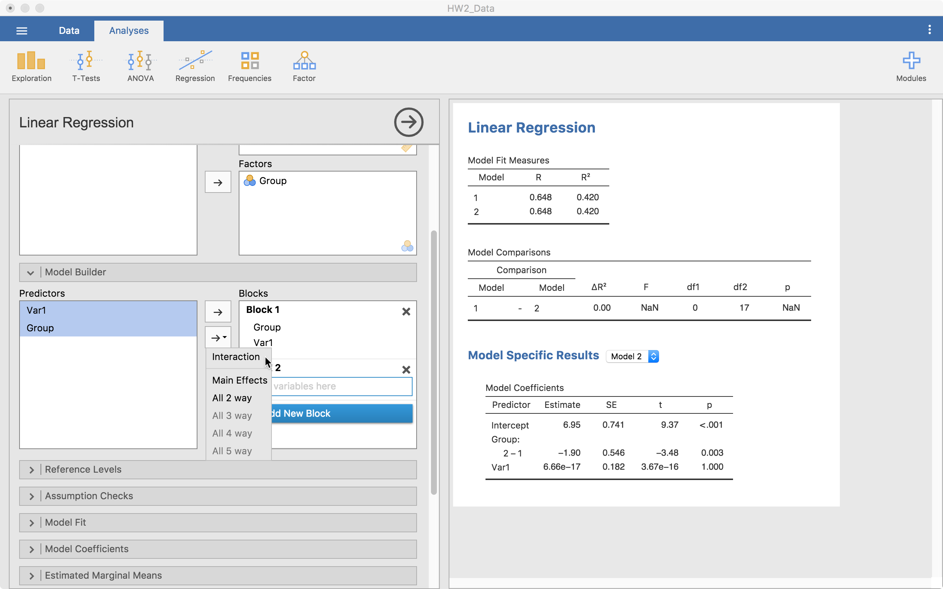
Interactions
Can tell Jamovi to do an interaction

Slide 53
Challenge
For the following situations, describe what approach you would take and why:
You have data on life satisfaction and age and want to the know the relationship between them. They are both continuous.

Slide 54
Challenge
For the following situations, describe what approach you would take and why:
You have data on life satisfaction and age and want to the know the relationship between them. You believe that age causes an increase in life satisfaction. They are both continuous.

Slide 55
Challenge
For the following situations, describe what approach you would take and why:
You have data on life satisfaction and age and believe that the relationship between them depends on a third variable – social class. Social class is categorical while the others are continuous.

Slide 56
Challenge
For the following situations, describe what approach you would take and why:
You have multiple waves of data wherein the participants have received an intervention between times 1 and 2. There are a total of 3 time points.

Slide 57
Challenge
For the following situations, describe what approach you would take and why:
You have a binary outcome and you think that the continuous variable “var1” predicts which category of the outcome the individual belongs to.

Slide 58
In-class discussion
slides

Slide 59
Application
Example Using
The Office/Parks and Rec Data Set
Hypothesis Test with
Regression

